Slide 1
Economic Value Analysis Incorporating ‘value’ into pricing
Pricing Strategies
2025
Jean-Pierre Dubé
© Copyright 2025

Slide 2

Canvas
If you have not already done so, please go to Canvas to review
All course documents
Introductory video for course

Slide 3
Overview
From the intro video you were reminded that
So now we will discuss:
Bringing value into pricing decisions with EVC framework
Example: Kone mini-case
Marketing coordinates Pricing with the value delivered to customers.

Slide 4

I. Value and Willingness-to-Pay

Slide 5
The EVC Framework
Need framework to put ourselves into customer’s shoes to assess perceived value qualitatively &, possibly, quantitatively
We will use a microeconomic theory to determine value
How much is the product worth to the buyer?
What is the buyer willing to pay?
Economic Value to the customer (EVC) model

Slide 6
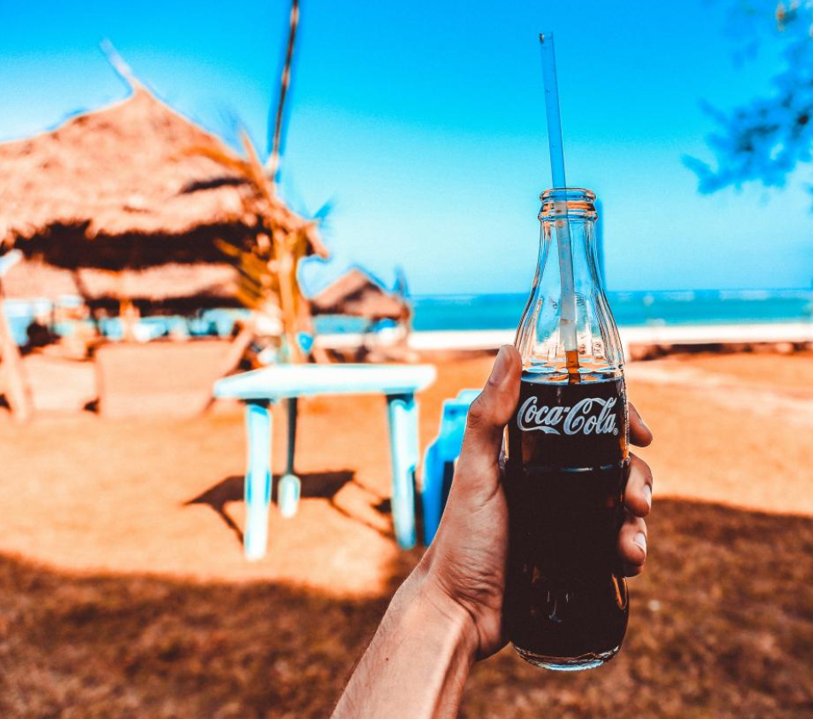
Theory: Use value vs Economic Value Coca Cola on the beach
Suppose your satisfaction from drinking a cold bottle of Coca Cola on the beach is US$35
(HK$270 & £27)
Would you pay $35 for a bottle of Coke?
Notes:
Explain use value vs economic value

Slide 7
Economic Value to the Customer (EVC)
Economic Value
to the Customer
Reference
Value
Differentiation
Value
R
ΔV
EVC
Reference Value - Price of what customer views as best substitute
Differentiation Value -Value of differentiating attributes

Slide 8
Economic Value to the Customer (EVC)
Economic Value
to the Customer
Reference
Value
Differentiation
Value
R
ΔV
EVC
Reference Value - Price of what customer views as best substitute
Differentiation Value -Value of differentiating attributes
Economic value defined “relative” to what competition offers

Slide 9
Economics of Buying Behavior The Maximum-Willingness-to-Pay (WTP)
Assume customers choose based on Net Value
Customer Choice - Select Our Product if:
Our Product
Our Benefits – Our Price
= V_{Us} - P_{Us}
Competitor’s Product
Their Benefits – Their Price
= V_{Them} - P_{Them}
[V_{Us}-P_{Us}] ≥ [V_{Them}-P_{Them}]
(V_{Us}-V_{Them}) + P_{Them} ≥ P_{Us}
ΔV + R ≥ P_{Us}
ΔV = Differentiation Value
R = Reference Value
EVC

Slide 10

Calculating economic value
Steps Involved
1
Identify the cost of the competitive product or best available substitute process (i.e., the benchmark or reference value)
2
Identify all factors that differentiate the new product from the reference product or substitute process (+ or - , objective or subjective)
3
Determine the economic value to the customer of the differentiating factors
4
Sum the reference value and the differentiation value to determine the total economic value to the customer

Slide 11


An EVC case study Kone - The Monospace Launch
Now we have an EVC framework
How can we use EVC to conduct basic analytics for a new venture?

Slide 12
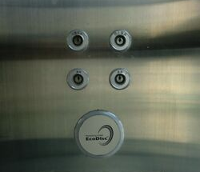
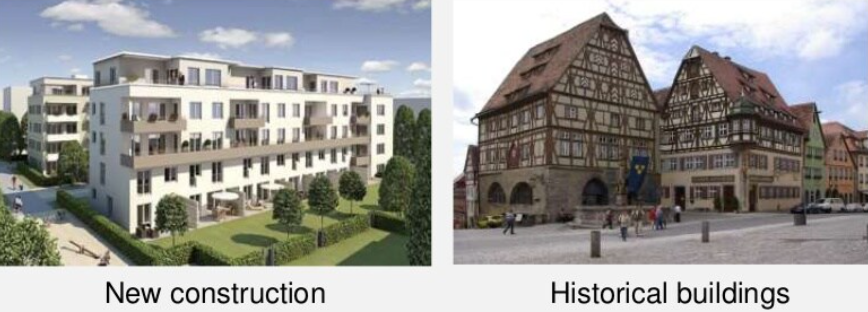
An EVC case study Kone - The Monospace Launch
12
New Ecologically-friendly elevator
Uses less oil and energy (Ecodisc)
Doesn’t require machine room (Monospace)
Planning launch in Eastern German market
See short PDF of Canvas

Slide 13
An EVC case study Kone - The Monospace Launch
11,500 prospective properties identified
Classified into 3 segments (based on reference products)
Hydraulic elevators with machine room on first floor
6,900 planned
Geared elevators with machine room below shaft
1,495 planned
Geared elevators with machine room above shaft
3,105 planned

Slide 14
An EVC case study Kone - The Monospace Launch
 | Segment 1 | Segment 2 | Segment 3
Reference Value
Reference Product | Hyrdaulic 1st floor (PH) | Geared top shaft (PT) | Geared bottom shaft (PU)
RV: Price of Ref. Product (DM) | 60,000 | 75,000 | 80,000
Differentiation value (10yrs)
Machine room savings (DM) | 15,000 | 18,750 | 20,000
Energy consumption (DM) | 42,000 | 20,000 | 20,000
Oil requirements (DM) | 10,000 | 1,000 | 1,000
Fuses (DM) | 15,400 | 7,400 | 7,400
DV (DM) | 82,400 | 47,150 | 48,400
EVC = DV + RV | 142,400 | 122,150 | 128,400
Market size | 6,900 | 1,495 | 3,105

Slide 15
An EVC case study Kone - The Monospace Launch
Segment 1
EVC & crude data
preliminary analytics on
Objective value to customers
pricing power by segment
Segment 3
Segment 2

Slide 16
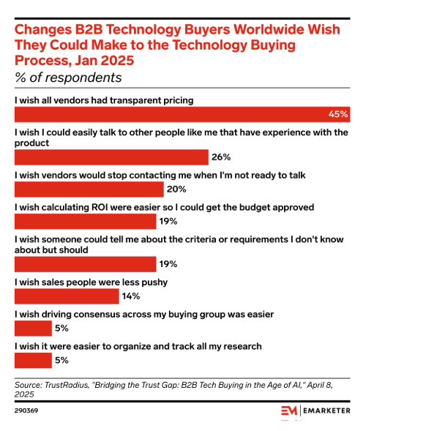
EVC case study B2B tech buyers WANT price transparency

Slide 17
Kone: Decomposing the Value example: segment 1
Kone Hydraulic
Economic Value to developer/property mgr
Energy/oil/fuses
Machine Rm.
What Kone can charge
Customer insight
&
Sales Material
Energy/oil/fuses
Price of Hydraulic
Options Available

Slide 18
EVC as an analytic tool
Kone conducted EVC “by hand:” case study approach
EVC case studies more practical in B2B settings, like industrial supply, with small number of measurable performance attributes
Consumer goods: product features/benefits often intangible
Brand/reputation
Service
B2C industries: Conjoint Analysis is an approach used to measure the differentiation value (also used in services industries)
See extra slides & lecture on conjoint analysis

Slide 19


Coordinating the 4Ps to create EVC This is marketing in a nutshell
Marketers use the 4 Ps to create, manage & monetize value
Product
EVC
Pricing
power
Promotion
Place
Use 4Ps to drive WTP!
See Appendix for examples of 4 Ps and value creation

Slide 20
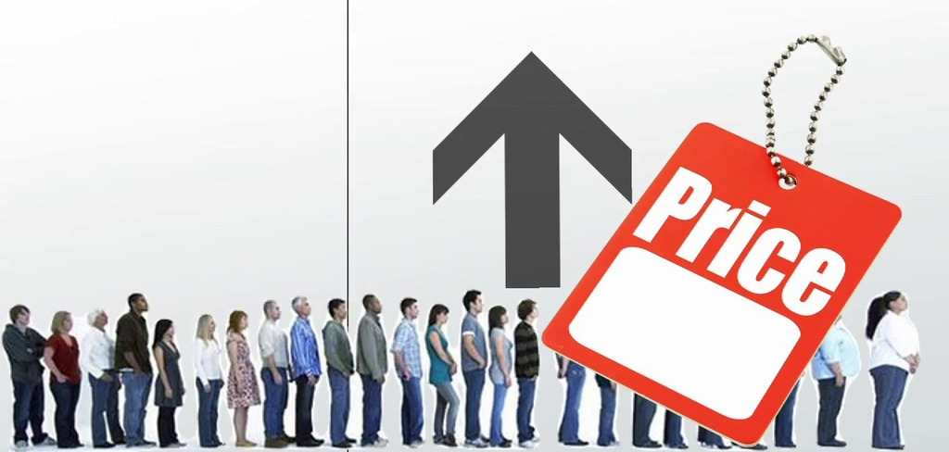
II. EVC, Demand & the Monetizable Opportunity

Slide 21
EVC and Demand
So far, only defined willingness-to-pay (i.e., EVC) of a customer
Suppose unit cost for a Kone elevator is 65,200 DM
Let’s use our EVC measures to set the Monospace list price
The Uniform Pricing Structure

Slide 22
EVC & Pricing Trade-offs Example: Kone Monospace Launch
Segment 1
What are the pricing trade-offs?
Segment 3
Segment 2
unit cost
65,200 DM

Slide 23
EVC & Pricing Trade-offs Example: Kone Monospace Launch
Segment 1
What does a demand curve look like?
Segment 3
Segment 2
unit cost
65,200 DM

Slide 24
Deriving Demand from EVC Example: Kone Monospace Launch
unit cost
65,200 DM

Slide 25
Deriving Demand from EVC Example: Kone Monospace Launch
True Demand
EVC approximation of demand
unit cost
65,200 DM

Slide 26

III. Demand and Optimal Pricing

Slide 27
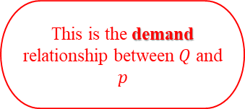


The Pricing Decision Setting the Profit-Maximizing Price
Business Objective
Set price$\text{(}p\text{)}$ to maximize variable profit:
$$\left(p \text{−} c\right)×\text{Q}\left(p\right)$$
These are the data and quantitative measurements you need for pricing
This is the demand relationship between $Q$ and $p$
This is the marginal (i.e., unit) cost
Note: some firms claim to maximize share. Does that objective make sense?
➔ see “New Model: At Ford Motor, High Volume Takes Backseat to Profits” WSJ, May 2004.

Slide 28




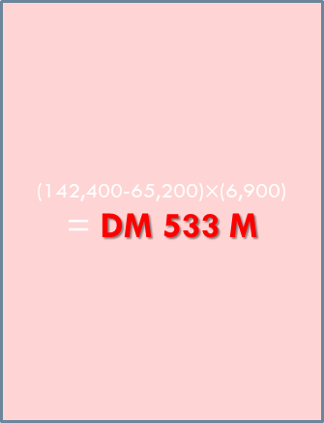

The Kone Pricing Decision
Price
$P^{A}$=DM 142,400
(142,400-65,200)$×$(6,900)
= DM 533 M
$P^{B}$=DM 128,400
$P^{C}$=DM 122,150
unit cost=DM 65,200
Segment 1
Segment 3
Segment 2
Quantity
Q^{A}=6,900
Q^{B}=10,005
Q^{C}=11,500
$P^{∗}=most profitable of \left\{P^{A}, P^{B}, P^{C}\right\}$
profit(P^{A}) = (P^{A} – 65,200) $×$Q^{A}

Slide 29
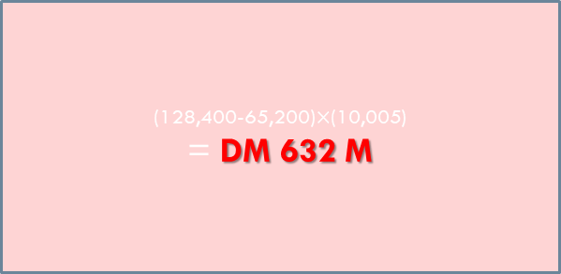

The Kone Pricing Decision
Price
$P^{A}$=DM 142,400
$P^{B}$=DM 128,400
(128,400-65,200)$×$(10,005)
= DM 632 M
$P^{C}$=DM 122,150
unit cost=DM 65,200
Segment 1
Segment 3
Segment 2
Quantity
Q^{A}=6,900
Q^{B}=10,005
Q^{C}=11,500
$P^{∗}=most profitable of \left\{P^{A}, P^{B}, P^{C}\right\}$
profit(P^{B}) = (P^{B} – 65,200) $×$Q^{B}

Slide 30


The Kone Pricing Decision
Price
$P^{A}$=DM 142,400
$P^{B}$=DM 128,400
$P^{C}$=DM 122,150
(122,150-65,200)$×$(11,500)
= DM 655 M
unit cost=DM 65,200
Segment 1
Segment 3
Segment 2
Quantity
Q^{A}=6,900
Q^{B}=10,005
Q^{C}=11,500
$P^{∗}=most profitable of \left\{P^{A}, P^{B}, P^{C}\right\}$
profit(P^{C}) = (P^{C} – 65,200) $×$Q^{C}

Slide 31

The Kone Pricing Decision
Price
$P^{A}$=DM 142,400
See Appendix for visuals on selling the price to a customer
$P^{B}$=DM 128,400
$P^{C}$=DM 122,150
(122,150-65,200)(11,500)
= DM 655 M
unit cost=DM 65,200
Segment 1
Segment 3
Segment 2
Quantity
Q^{A}=6,900
Q^{B}=10,005
Q^{C}=11,500
Optimal Price: DM 122,150

Slide 32
Pricing & Value
Our pricing decision balanced:
Value (via EVC)
Competition (via EVC)
Costs

Slide 33
Demand Measurement
Demand measurement is major obstacle to optimized pricing
There are alternative methods:
Measure EVC via expert judgment & case study
(today, CMI Case)
Regression analysis of point-of-sale data
(module 2 & extra slides, stats course)
Price Experiments
(module 2)
Conjoint Analysis
(extra slides)

Slide 34
Take Away
EVC is a conceptual framework for the Value Proposition
Highly useful qualitatively
In some instances, also useful quantitatively
We will use EVC throughout modules to guide our thinking
The Uniform Pricing structure
To tie marketing decisions to value, you must know demand
E.g., use demand to set profit-maximizing price!
Balancing act: value, costs & competition
day 2
day 3

Slide 35

Appendix: Identifying and Measuring Differentiation Value & the 4P’s

Slide 36
Sources of Customer Value
There may be more than 2 segments
 | Segment 1 | Segment 2
Availability
Convenience
Functionality
Relationship
Exclusivity
Ideally, measure in $ equivalents (contribution to total WTP)
Many firms use conjoint analysis (see extra slides)
Notes:
Availability: having the product or service capacity when competitor’s don’t.
Convenience: allowing the customer to quickly and easily acquire the product or service
Functionality: product and service features that are unique as well as valued by the customer
Relationship: vendor features that create trust and satisfaction in the customer
Exclusivity: exclusive access to products (e.g. unique models, Own Brands etc)

Slide 37
Value Inhibitors
There may be more than 2 segments
 | Segment 1 | Segment 2
Time
Place/Search Costs
Risk
Design Compromise
Learning Costs
Be sure to account for EVC inhibitors
Again these could be expressed in $ equivalents

Slide 38
Coordinating the 4Ps to create EVC This is marketing in a nutshell
Marketers use the 4 Ps to create, manage & monetize value
Product
EVC
Pricing
power
Promotion
Place
Use 4Ps to influence WTP!

Slide 39
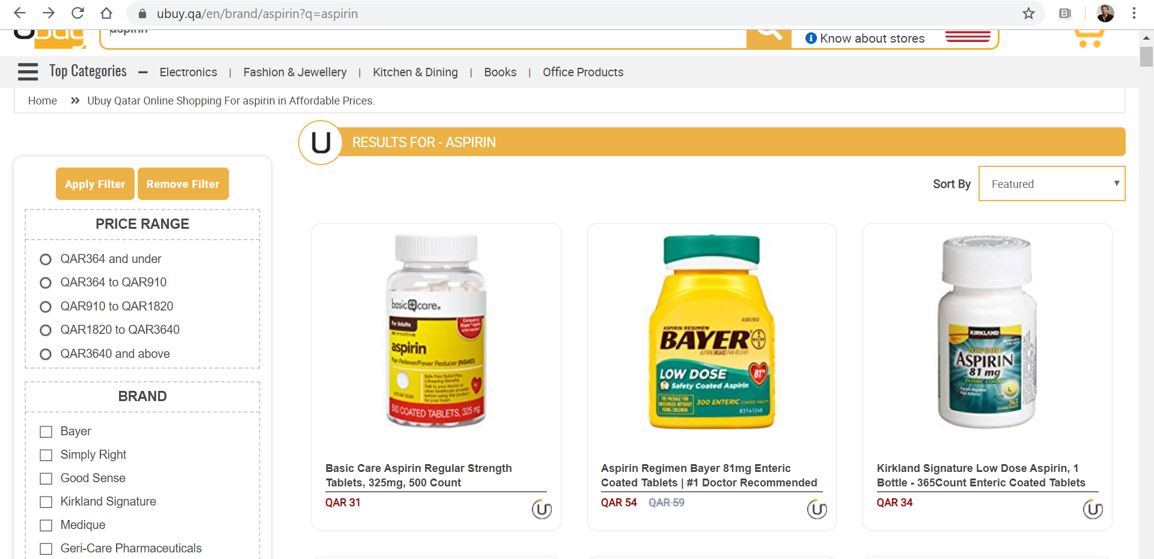
Brand Reputation and Perceived Value Example: Large online Qatari pharmacy
39
Copycat store brand has same active ingredient & similar packaging as Bayer brand.
How much of this 74% price premium is just misinformation?

Slide 40
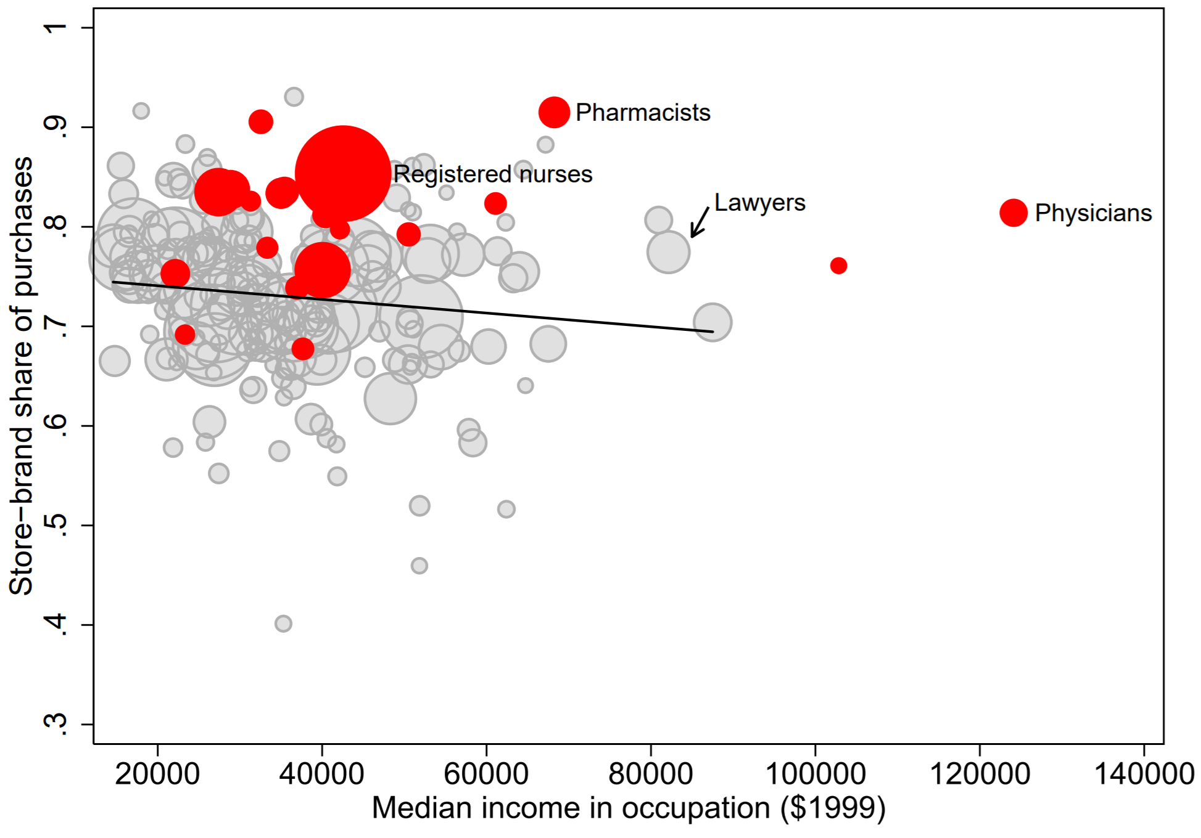
Brand Reputation & Perceived Value Experts aren’t fooled
Big Data
purchases for over 100,000 US households
Pharmacists buy 91% unbranded headache medicines
Average non-healthcare worker buys only 74% unbranded
Source: Bronnenberg, Dubé, Gentzkow & Shapiro (2015)

Slide 41


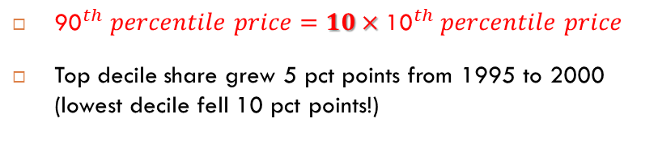
Brand Reputation & Perceived Value Brands also matter in Financial Services!
82 undifferentiated products in US in 2000
Big Brands
Prices for Retail and Institutional S&P 500 Index Funds in 2000
(annual fees + 1/7th of total loads)
${\text{90}}^{th} \text{percentile} \text{price}=10×{\text{10}}^{th} \text{percentile} \text{price}$
Top decile share grew 5 pct points from 1995 to 2000 (lowest decile fell 10 pct points!)
Source: Hortacsu & Syverson (2004)

Slide 42
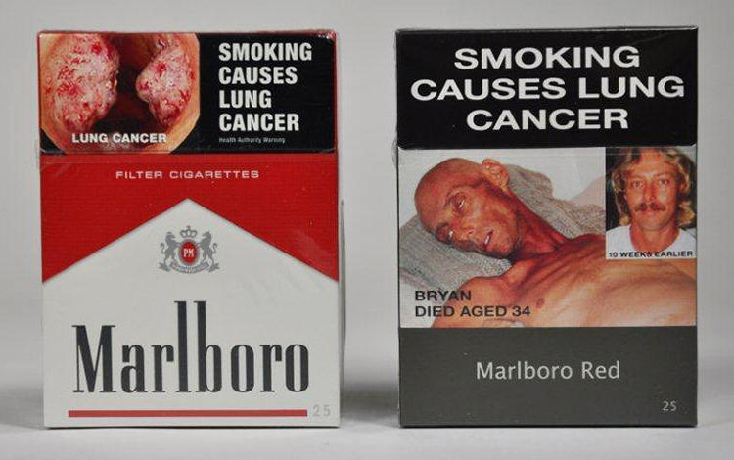
Packaging can Communicate Value Plain Packaging in Australia
Packaging can affect perceptions and WTP
$150,000 (1950s) on research to reposition Marlboro cigarette packaging to male consumers
120 designs were researched and tested
“red packs connote strong flavor …white packs suggest that a cigarette is low tar”
Australia plain packaging law (2012): all tobacco packaging color is “drab brown”
before

Slide 43
Packaging can Communicate Value Plain Packaging in Australia
Packaging can affect perceptions and WTP
$150,000 (1950s) on research to reposition Marlboro cigarette packaging to male consumers
120 designs were researched and tested
“red packs connote strong flavor …white packs suggest that a cigarette is low tar”
Australia plain packaging law (2012): all tobacco packaging color is “drab brown”
before
after
“Customers are continually complaining about the taste of their cigarettes and refuse to believe that the tobacco has not changed.”
The Australian Retail Tobacconist, 2013
Months after PP was enacted.

Slide 44
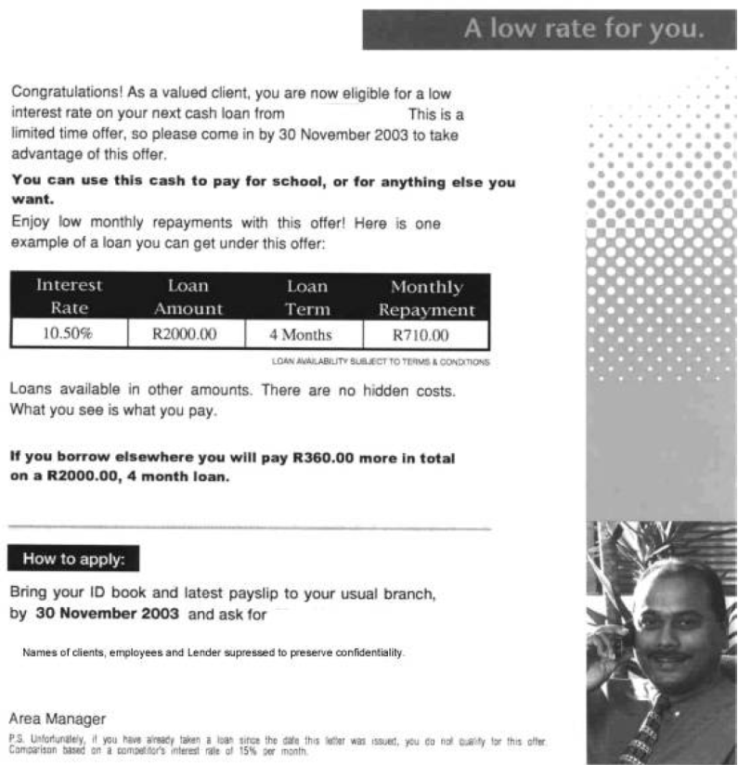



Direct Marketing can Communicate Value Persuasive Advertising
Persuasive advertising can affect WTP
A Direct Mail field experiment with South African Bank
Switch to “attractive woman” increased loan applications by same amount as a 25% reduction in the interest rate charged.
Randomly switch image
Source: Bertrand et al (2010)

Slide 45
Kone Elevator
Selling the Price DM 122,150

Slide 46
“Selling” the price of DM122,150 segment 1 (PH)
DM 142,400 (EVC)
Fuses
DM 7,400
Oil
DM 1,000
Energy
DM 20,000
Machine Room
DM 20,000
DM 122,150 (price)
Kone’s incentive to sell:
= price – cost
=122,150-65,200
DM 65,200 (unit cost)
Reference
Value
DM 80,000

Slide 47
“Selling” the price of DM122,150 segment 1 (PH)
DM 142,400 (EVC)
Fuses
DM 7,400
Limitations of your marketing
Oil
DM 1,000
? (perceived value)
Energy
DM 20,000
Customer’s incentive to buy:
= perceived value - price
Machine Room
DM 20,000
DM 122,150 (price)
Kone’s incentive to sell:
= price – cost
=122,150-65,200
DM 65,200 (unit cost)
Reference
Value
DM 80,000

Slide 48
Etiquette, culture and price increases

Slide 49
Etiquette, culture and price increases
Price increases should consider social norms and etiquette
Norms and etiquette vary across countries and cultures
In Japan, price increases often require “apology” advertising:
“Inflation Means Never Having to Say You’re Sorry”
Miho Inada, Wall Street Journal, August 10, 2022
Some cultures expect to barter. So start high with a number you can afford to lose.
“Negotiating with a Customer You Can’t Afford to Lose”
Thomas C. Keiser, Harvard Business Review, Nov. 1988

Slide 50
Price Negotiations across cultures
Negotiation Styles:
USA: Speed, cost and efficiency
Canada: Information sharing and problem solving
China: A soft sell and a hard buy
Norway: Collaboration and consensus
United Arab Emirates: Price and relationships
Australia: A sense of fair play
Zambia: Flexibility and commitment
Source: “Differences In Negotiating Across Cultures,” Country Navigator, August 2, 2021.
https://www.countrynavigator.com/blog/negotiating-across-cultures/

